Slide 1
DDoS
Attack Analysis &
Response Playbook
KIT325 – Group 13

Slide 2
Introduction
DDoS attacks can overwhelm services, exhaust resources and block legitimate users.
Highly disruptive: impact ranges from short outages to prolonged service degradation.
Our hands-on simulations bridge theory and practice through safe repeatable experiments in an isolated virtual lab.
Builds skills and knowledge in traffic analysis, detection techniques and incident response.
Delivers reusable artefacts (PCAP libraries, playbook, threat landscape report) for future education and operations.

Slide 3
Goals and Scope
Primary Goals
Design, implement and evaluate DDoS simulations in a virtualised environment.
Develop a comprehensive DDoS response playbook (detection, containment, mitigation, recovery).
Produce supporting artefacts.
In Scope
Examination of key DDoS types: volumetric, protocol-based, application layer.
Isolated lab with 3 VMs: Attacker, Target, Observer.
Analysis to identify attack-specific traffic anomalies and inform the response playbook.
Out of Scope
High volume / production scale attacks against live systems.
Success Criteria
Validated lab simulations and reproducible PCAPS.
A clear, practical response playbook with stepwise actions.
Complete technical documentation and deliverables submitted by the deadlines.

Slide 4
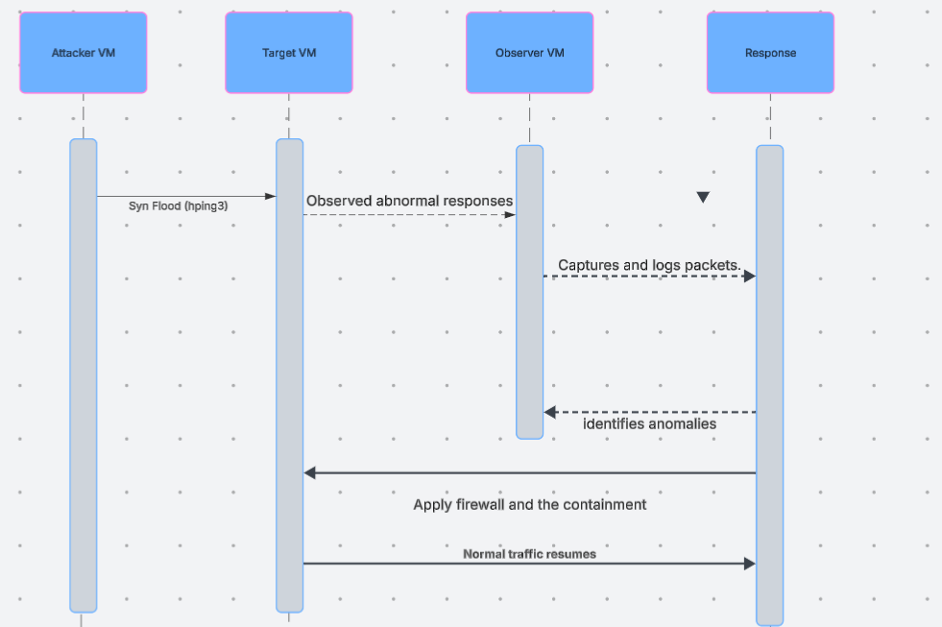
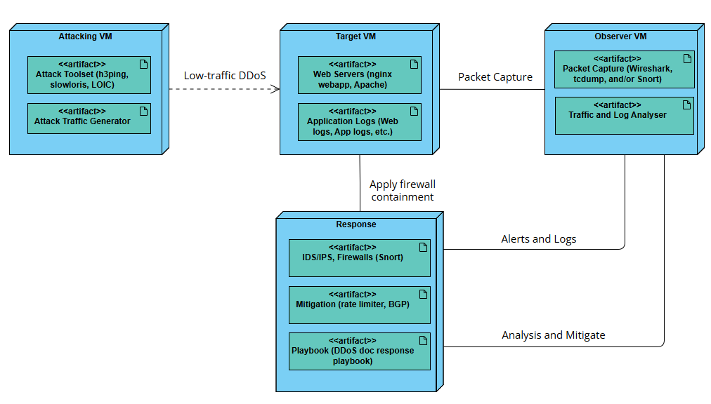
Lab Environment Setup

Slide 5
Tools Used
Area Used | Tools
Attack Simulation | Hping3, slowhttptest, LOIC
Traffic Capture | Wireshark
Analysis | Wireshark Filters
Documentation | Word, Powerpoint

Slide 6
Attack Types Simulated
SYN Flood (TCP Based)
UDP Flood (Protocol Based)
HTTP Slowloris (Application Layer)

Slide 7
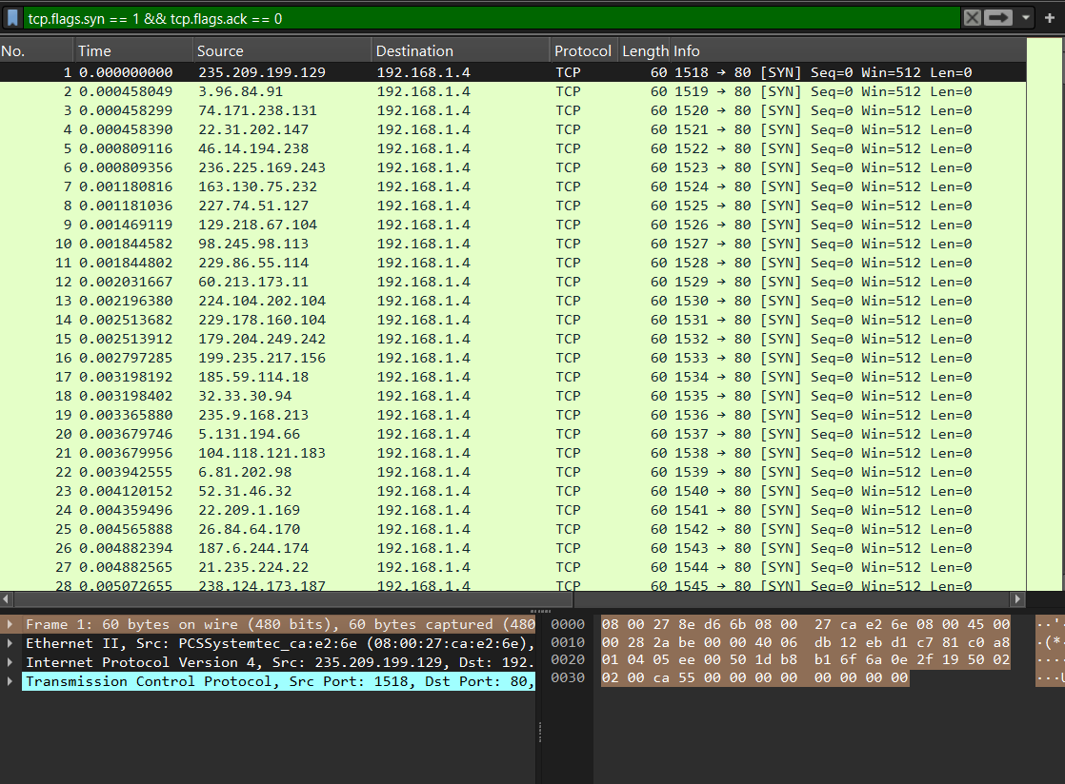
SYN Flood Artefacts
Observations
Large volume of SYN packets with no or few ACK packets
Impact
Server becomes unresponsive

Slide 8
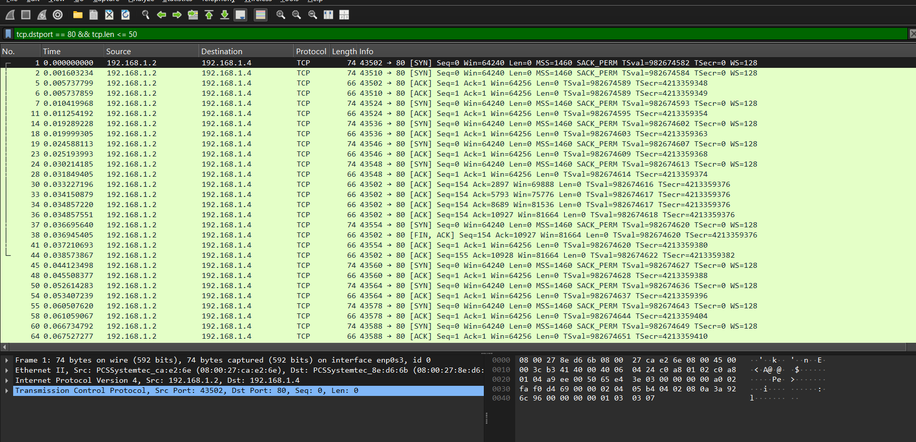
Slowloris Artefacts
Observations
Incomplete HTTP headers
Impact
Web server slows or down entirely

Slide 9
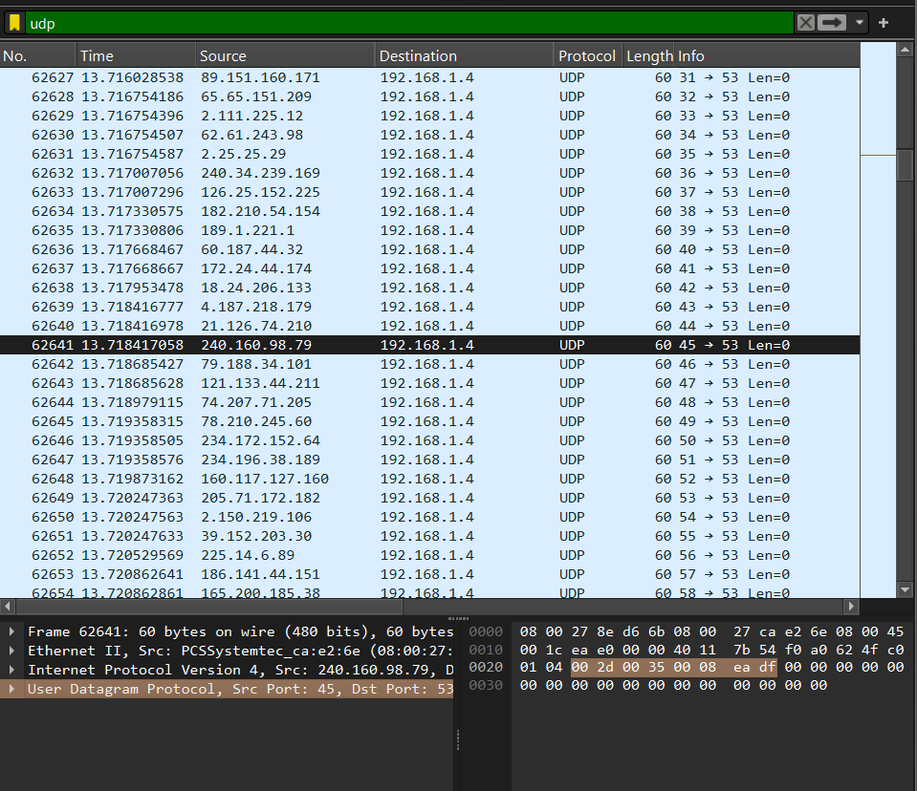
UDP Flood Artefacts
Observations
Random UDP packets to ports
Impact
Bandwidth saturation, legitimate traffic is dropped or severely delayed

Slide 10
Challenges
Setting up required VMs with limited hardware capability.
Running attacks safely without overloading the host machine.
Choosing appropriate tools for simulations and understanding how they and their commands work.
Applying correct filters for traffic to isolate attack packets.

Slide 11


Future Improvements
Snort/Suricata rules implementation
Automation tools
High-Volume simulations using cloud
Image References:
Snort. (n.d.). Snort - Network Intrusion Detection & Prevention System. Www.snort.org. https://www.snort.org
Suricata. (n.d.). Observe. Protect. Adapt. Suricata. https://suricata.io

Slide 12
DDoS Response Playbook
Summary
Measures written in the Playbook:
  For Detection: Traffic indicators, analysis of logs and tools used for monitoring.
  For Containment: Network Isolation, rate limiting and IP blocking.
  For Response Team: Having clear roles and responsibilities during the incident.
  For Recovery: Restoring network connection, documenting and preserving evidence of the attack.
  For Post-incident: Security patching, validation, and documenting lessons learned during the incident.

Slide 13
Reflection & Project Outcomes
Hands on understanding of DDoS mechanisms.
Improved knowledge of network traffic analysis.
Applicable skills in incident response planning.
Importance of documentation and teamwork.

